Slide 1
Outcomes of the EXCESS research on smart regulation and incentives Session 2: How to encourage PEB take-up via smart regulation and incentives? Mia Ala-Juusela VTT & Andreas Jäger ICLEI; 3.2.2021

Slide 2
Contents
Background: regulations related work in EXCESS so far
Case studies and regulations related conclusions from them
Recommendations for city and regional authorities
Recommendations based on the barriers and incentives study
Conclusions: common findings in the three studies?
Notes:
Outcomes of WP1 research (D1.2, D1.3 & D1.4)
Summary on researched case studies
Ideally grouping of experiences/outcomes

Slide 3
Regulations related work in EXCESS (so far)
Study on how Positive Energy Buildings (PEBs) could be taken into account in urban and regional planning instruments
Interviews on municipal and regional representatives, experts and urban planners in 15 cities and regions across Europe
Guidelines developed based on these
Analysis of 10 case studies on existing PEBs
Research on barriers and incentives for PEBs
Interviews of wide range of stakeholders (18 interviewees)
Demo site workshops (79 participants)
Analysis of market and regulatory environment in the demo countries

Slide 4
PEB
NZEB
European Green Deal
ESD/ESR
European Climate Law – 2050 climate neutrality and at least 55 % GHG reduction 2030
European Climate Pact to engage citizens
Governance of the Energy Union and Climate Action
NECPs
Renovation
wave
ESD/ESR
National targets covering sectors outside EU ETS (e.g. buildings)
EPBD
Long-term renovation strategies, NZEB, support electro-mobility, promote smart technologies
EU ETS
Review and
revision of
EU ETS
and ESR
PEB
NZEB
EED
EU level energy efficiency target for 2030 of at least 32.5%, stronger rules on metering and billing of thermal energy
Review and
revision of
EED
EMD
Enable active participation of consumers (as individuals or in community) in all markets (generate electricity - consume, share or sell it, or provide storage services)
RED
At least 32 % EU-level RE target, RE in heating and cooling,RE communities, RE self-consumers
Review and
revision of
RED
EU Strategies for energy systems integration and hydrogen
Notes:
Shows at one glance the conclusions: 1) that there is need to align the regulations in different fields (buildings, energy, different levels of governance) and 2) There are a lot of elements supporting the PEBs in the upcoming regulations.

Slide 5
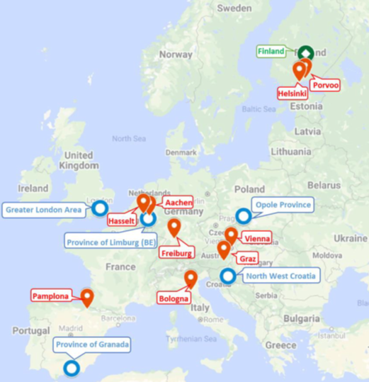
Interviews on authorities
Interviewed 9 city and 5 regional level authorities, 1 national level:
Experiences related to energy efficient and sustainable buildings
Role of NZEB and PEB in the policy and planning instruments
Technology related issues (EE & RES)
Learnings about assessing of PEBs, required KPIs and data
Governance and policy

Slide 6
Recommendations for authorities
Make room for PEBs in the overarching vision for sustainability.
Good outcomes require the inclusion of a wide variety of stakeholders.
Understand institutional arrangements and powers that influence PEB development.
Plan for positive energy at the individual building or building cluster level.
Lead by example, learn by doing and share information.
Strive for a sustainable built environment that leaves no one behind.
Support and knowledge for financing.
Policies and regulations as motivators rather than obstacles.
Notes:
For city and regional authorities
From the guidebook based on interviews
Survey on making PEB concepts part of local authorities planning instruments

Slide 7
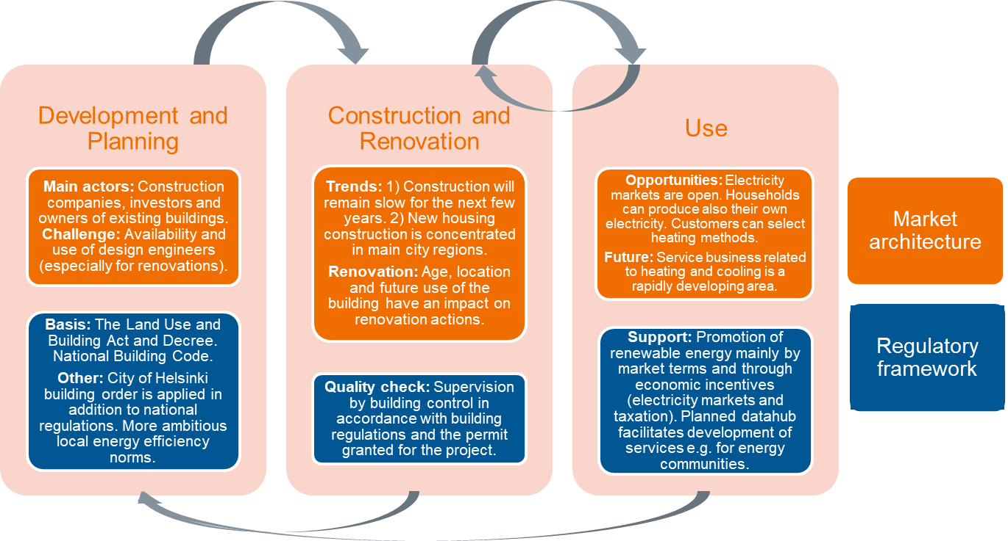
Research on barriers and incentives
Interviews on municipal and regional representatives, experts and urban planners in 15 cities and regions in EU.
Analysis of market and regulatory environments in the demo countries.

Slide 8
Market & regulatory environment (FI)

Slide 9
Findings: Regulatory barriers
Immaturity of regulations
Fragmentation of energy regulation (different fields and governance levels)
Inability of the regulations to handle different ownership structures and energy choices
Tight restrictions in historic buildings in combination with renewable installations

Slide 10
Findings: Regulatory incentives
Emerging regulatory framework for Local Energy Communities
Climate friendly regulation supports PEBs
Movement towards stricter energy efficiency targets on national level

Slide 11
Study on barriers and incentives

Slide 12
Recommendations – Technical & regulatory
Technical
Develop performance-based contracts, include maintenance.
Set up solid and experienced project management team to handle the complexity of the project.
Need for longer-term studies to show the energy savings compared to conventional systems.
Regulations
Develop an enabling, consistent (across various policy levels), stable and clear regulatory framework.

Slide 13
Recommendations – Social and financial
Social
Awareness raising campaigns to wide range of stakeholders including professionals.
Develop common, easily understandable Key Performance Indicators for PEBs.
Create tools and processes for peer-to-peer advice and information provision.
Financial
Funding and subsidies to support PEB solutions
The requirement to show the life-cycle effects should be made mandatory in the planning phase
Financing and incentive schemes at the national level
Introducing a CO₂ tax or an environmental tax could help in the roll-out of PEBs.
Notes:
Funding and subsidies to support PEB solutions. (Energy efficiency improvements and RES funding also helps)
The requirement to show the life-cycle effects (cost & environment) should be made mandatory in the planning phase. Financing and incentive schemes at the national level play a major role in promoting PEBs

Slide 14
Conclusions
The regulations are currently quite fragmented and not well aligned, but they seem to be developing towards enabling for PEBs.
The development of regulations calls for co-operation between stakeholders and different levels of governance.
In order to develop PEB supporting regulations, more information is needed of the concept and the challenges.
Incentives should be developed to support especially the lower-income people for acquiring PEBs

