Slide 1
EXCESS-Project Overview
Andreas Tuerk (JR), Coordinator
Francesco Reda (VTT), Technical coordinator
Advisory Board Meeting 8.2.2021

Slide 2

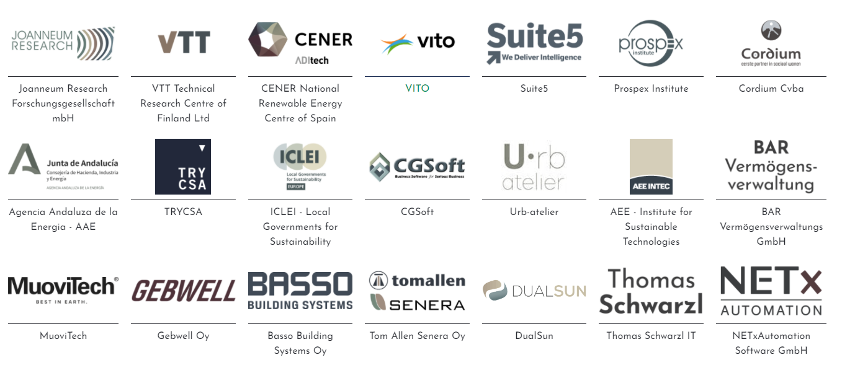
EXCESS: FleXible user-CEntric Energy poSitive houseS
EU Horizon 2020. Duration: 2019-2023. Innovation Action!
21 partners from 8 countries to showcase how nearly-zero energy buildings can be transformed into positive energy buildings.

Slide 3
Why EXCESS?
EU Clean Energy Package provides a range of new opportunties and possible revenue streams to improve the business case for PEBs
Important technical developments for PEBs materials and other technologies that are tailored to the needs of PEBs in different climates are required.
Inclusion of users and relevant stakeholders in the value key element for a fast roll-out

Slide 4
Aims of EXCESS
Advance new materials, technologies and integrated technological systems (TRL5-7) for different climate zones
Optimize interplay of local generation, storage, consumption at the building and district level capitalizing on new ICT opportunities
Demonstrate PEBs solutions for the main EU climate zones
Promote a user centric approach, involving the user aspects in every optimization process
Co-Innovation, replication and exploitation activities with a wide range of stakeholders to maximize technical, social and economic impact

Slide 5
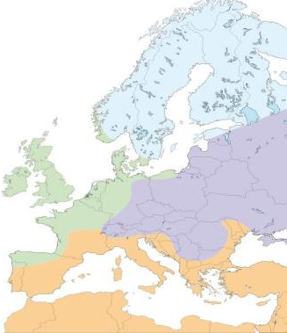
4 demos in 4 European climate zones
Conventional solar technologies will be used in mediterranean and continental climates (where solar irradiance is high). In these demos technology integration is key
Innovative RES solutions in oceanic and nordic climates
    advanced PVT, wind and a deep borehole
All demos: advanced interaction with the grid as well as with consumers

Slide 6
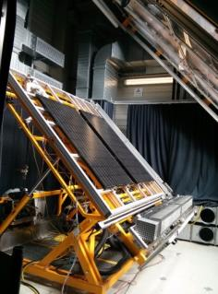
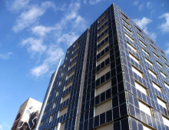
Technological advancements
Hardware
PVT panels for a multisource ground source heat pump
Multisource heat pumps development
High COP DHW system
Electrical and thermal flexibility at a substation
Multifunctional façade element
Software
Integrated PEB controller
Flexibility analysis and forecasting component
Optimal control strategies for energy system
User-centred positive energy solutions

Slide 7
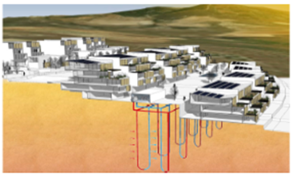
Demo Site Spain, Granada
(Mediterranean Climate)
Integrating PV, geothermal heat pump with energy storage (battery) and electric vehicle charging system as one controllable system.
HMI system (human-machine interface) for intelligent management of energy, management and control of the installation.
Energy sharing and trading. BEMS will decide on best strategy to reduce overall energy consumption. Excess energy will be shared.
First planned zero energy
district, called Nivalis

Slide 8
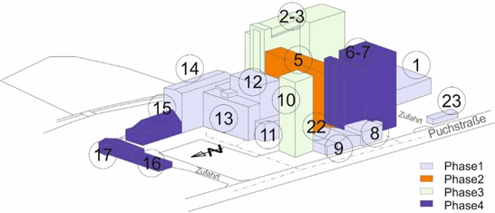
Demo Site Austria, Graz
(Continental Climate)
Multifunctional Façade element with integrated PV. The outer layer will generate electricity, while the most inner layer will deliver heat or cooling energy to the existing external building walls.
Cascading geotghermal heat pumps with with a community battery and electric vehicle charging system as one controllable system.
Energy community smart control system and energy billing concept for the entire energy supply for all buildings and facilities via block chain.
Whole building complex
Tagger-Area and buildings *)
*) Source: BAR Vermögensverwaltung GmbH)

Slide 9
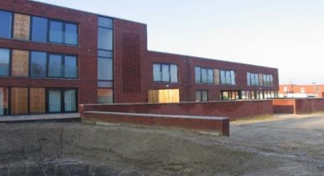
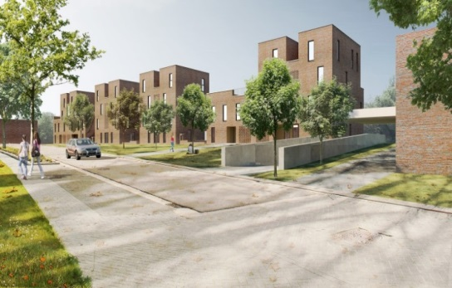
Demo Site Belgium, Hasselt
(Oceanic climate)
Social housing complex:
  35 kWel PVT panels for multisource ground source heat pump to supply heat and electricity to the building
  Windmill on the roof
  Power-To-Heat flexible thermal storages to be integrated in the decentralised DHW substation units adding additional source of flexibility to the local district heating system
Social housing
apartment buildings

Slide 10
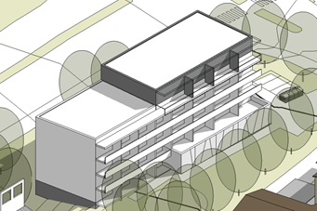
Demo site Finland, Espoo
(Nordic Climate)
Deep boreholes 3x800m (drilling technology and heat exchangers collector)
Multisource ground source heat pump system for deep boreholes with high COP for District Heating Water
70 kWel PVT panels:
  for multisource ground source heat pump with defrosting function
Seasonal borehole storage. PVT heat surplus will be used to charge the ground during transitional months
Finnish demonstration
building

Slide 11
Unlocking flexibilities and virtual trading
Demand side flexibility profiling mechanisms
  deliver context-aware flexibility profiles
Advanced forecasting algorithms for short- and mid-term accurate demand and generation forecasting
Blockchain-enabled environment and applications for increasing self-consumption and introducing energy communities through peer-to-peer energy sharing and flexibility trading.
Establishing PEBs/PEDs as energy communities

Slide 12
User engagement and replication
Co-design of PEBs concepts and planning documents with all relevant stakeholders (e.g. architects, engineers, building managers, ICT experts)
  Understand stakeholder needs and involve them in the co-design of the solutions in the pilot site.
  Scalable, generic business cases as well as a roadmap for upscaling the PEB concept.
Creating an enabling environment for a later market roll-out of EXCESS technologies and solutions

Slide 13
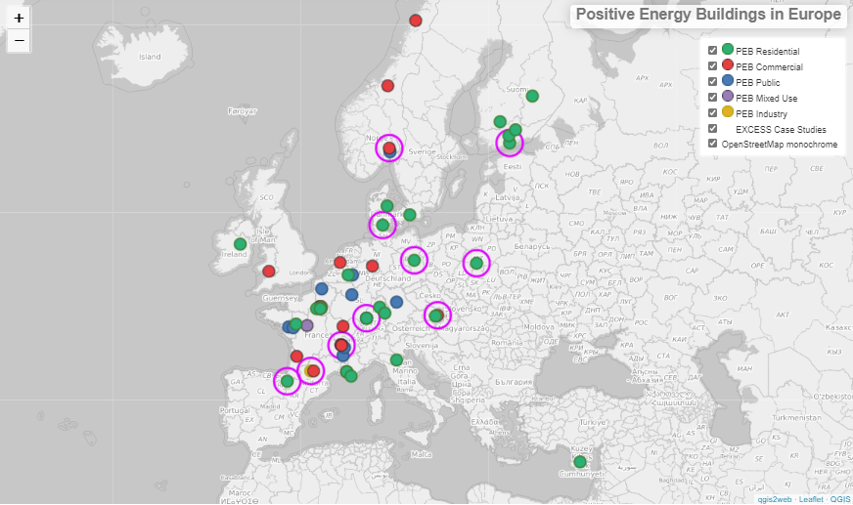
Achievments made so far
PEB definition, Stocktaking of PEB examples
Identification of regulatory and market incentives and barriers
First stakeholder Workshops in the demo countries
Major innovations related to PED technologies

Slide 14
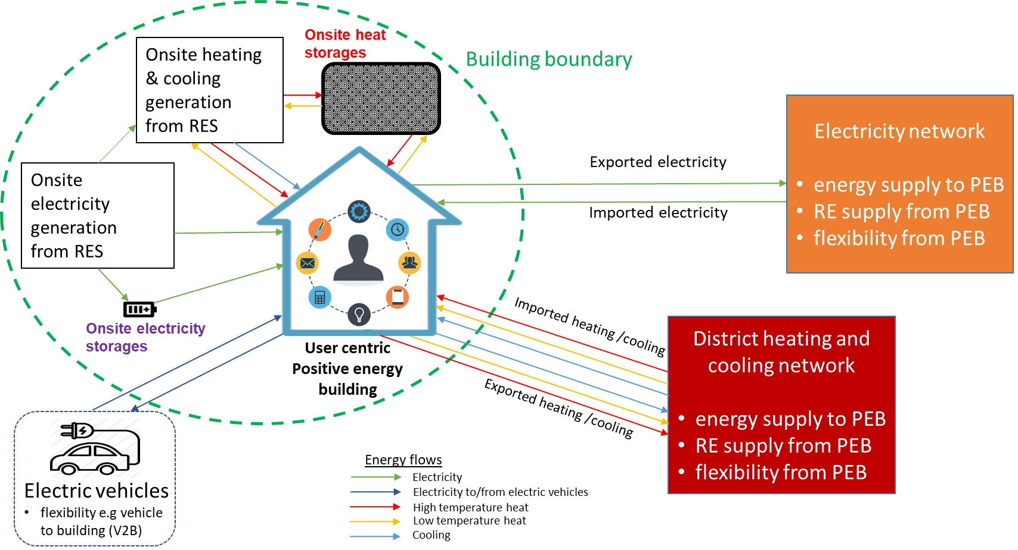
PEB definition
energy efficient building that produces more energy than it uses via RES, with high self- consumption rate and high energy flexibility, over a time span of one year. A high-quality indoor environment is an essential element in the PEB, maintaining the comfort and well-being of the building occupants.
Source: VTT
The PEB is also able to integrate the future technologies, such as electric vehicles with the motivation to maximize the onsite consumption and also share the surplus renewable energy

Slide 15

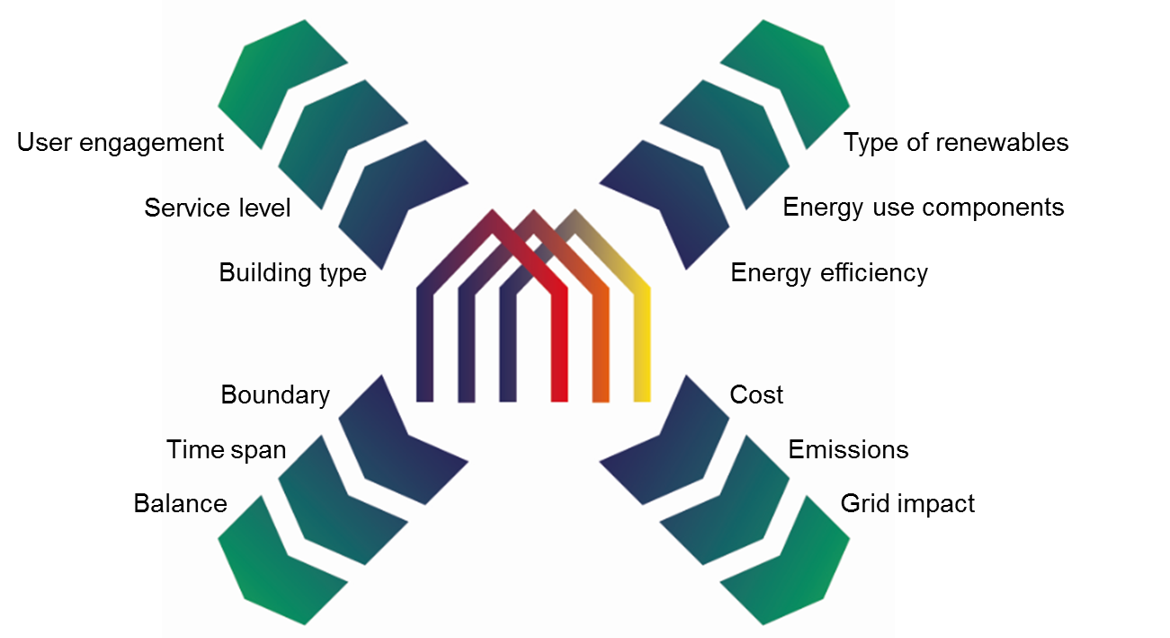
EXCESS PEB definition
Cooperation with:
  sister projects to have a consolidated definitions
  Initiaves: New IEA Annex83 on PEDS and COST Action PED EU NET
EXCESS Report Available here:
https://positive-energy-buildings.eu/resources

Slide 16

Design principles and test result of multisource Solar Assisted heat pumps with high COP DHW
VTT carried out simulations to design the test rig, whilst partners GEBWELL and TAS developed the rig and executed tests.
Two different compressor technologies, namely a 100kW inverter piston compressor and a 100kW enhanced vapor injection (EVI) scroll compressors were tested. Both technologies have been proven to work technically well.
Combining the PVT panels the heat pump worked well
Breakthrough a for densely built environment areas (heating dominated, recharging ground) as heat pump market is booming

Slide 17

Mid-deep 800m Borehole collector: Design, safety and performance tests
MUOVITECH has developed the specifications of the deep borehole collectors (hydronic & borehole design settings on flow rates, pressure and antifreeze fluid to be used, etc.). in preparation for the installation of 800m deep boreholes in the Finish demo case.
The suggested collector is a closed loop coaxial collector.
Increase the efficiency of the heat pump contributing to the EXCESS solution for densely built environment, less boreholes les holes

Slide 18

Optimising PVT
DUALSUN has carried out tests of PVT panels, optimised to power a multisource ground source heat pump. The analyses focused on different fluids, pressures, the cost and certification compliance of the improved PVT.
Increase the efficiency of the heat pump contributing to the EXCESS solution for densely built environment & less installation burden (easy fix, quick installation no welding, plug & play)

Slide 19
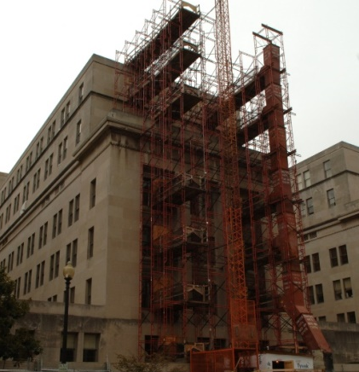
Testing performance and safety of prefabricated multifuncional façade modules
AEE INTEC has designed and tested façade modules that can be mounted to the exterior of an existing building to improve its energy performance (electricity, heating and cooling).
Final design composed of a metal construction that achieves a high insulation standard (<0,15W/m²K), characterized by a high degree of prefabrication (1-2 modules per floor) and high performing active layer (copper pipes with aluminum heat conductive plate)
EXCESS multifunctional solution (insulation, harvest and energy delivery) for building renovation market

Slide 20

Simulation-based energy performance assessment for optimal PEB design
Support the final design of energy systems (system layout and dimensioning of components)
Maximize the performance of Energy System
First detailed assessment of the EXCESS PEB
Complex design, Knowledge transfer from Research Organizations to Industries and practitioners

Slide 21

Thank you!
Coordinator - Mr. Andreas Tuerk, Joanneum Research
Technical Coordinator - Dr. Francesco Reda, VTT

