Slide 1
Outcomes of the EXCESS research on smart regulation and incentives Session 2: How to encourage PEB take-up via smart regulation and incentives? Mia Ala-Juusela VTT & Andreas Jäger ICLEI; 3.2.2021

Slide 2
Contents
Background: regulations related work in EXCESS so far
Case studies and regulations related conclusions from them
Recommendations for city and regional authorities
Recommendations based on the barriers and incentives study
Conclusions: common findings in the three studies?
Notes:
Outcomes of WP1 research (D1.2, D1.3 & D1.4)
Summary on researched case studies
Ideally grouping of experiences/outcomes

Slide 3
Regulations related work in EXCESS (so far)
Study on how Positive Energy Buildings (PEBs) could be taken into account in urban and regional planning instruments
Interviews on municipal and regional representatives, experts and urban planners in 15 cities and regions across Europe
Guidelines developed based on these
Analysis of 10 case studies on existing PEBs
Research on barriers and incentives for PEBs
Interviews of wide range of stakeholders (18 interviewees)
Demo site workshops (79 participants)
Analysis of market and regulatory environment in the demo countries

Slide 4
PEB
NZEB
European Green Deal
ESD/ESR
European Climate Law – 2050 climate neutrality and at least 55 % GHG reduction 2030
European Climate Pact to engage citizens
Governance of the Energy Union and Climate Action
NECPs
Renovation
wave
ESD/ESR
National targets covering sectors outside EU ETS (e.g. buildings)
EPBD
Long-term renovation strategies, NZEB, support electro-mobility, promote smart technologies
EU ETS
Review and
revision of
EU ETS
and ESR
PEB
NZEB
EED
EU level energy efficiency target for 2030 of at least 32.5%, stronger rules on metering and billing of thermal energy
Review and
revision of
EED
EMD
Enable active participation of consumers (as individuals or in community) in all markets (generate electricity - consume, share or sell it, or provide storage services)
RED
At least 32 % EU-level RE target, RE in heating and cooling,RE communities, RE self-consumers
Review and
revision of
RED
EU Strategies for energy systems integration and hydrogen
Notes:
Shows at one glance the conclusions: 1) that there is need to align the regulations in different fields (buildings, energy, different levels of governance) and 2) There are a lot of elements supporting the PEBs in the upcoming regulations.

Slide 5
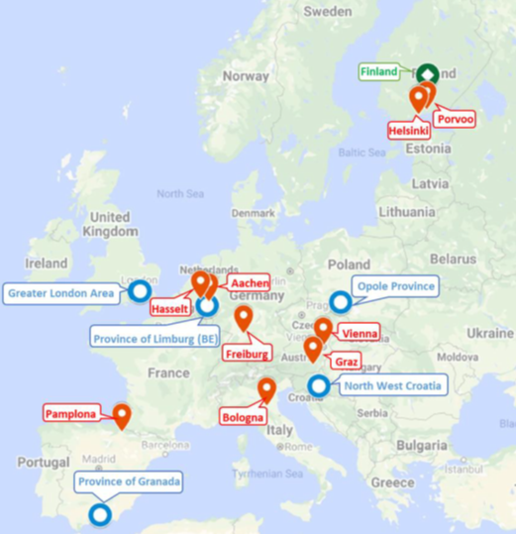
Interviews on authorities
Interviewed 9 city and 5 regional level authorities, 1 national level:
Experiences related to energy efficient and sustainable buildings
Role of NZEB and PEB in the policy and planning instruments
Technology related issues (EE & RES)
Learnings about assessing of PEBs, required KPIs and data
Governance and policy

Slide 6
Recommendations for authorities
Make room for PEBs in the overarching vision for sustainability.
Good outcomes require the inclusion of a wide variety of stakeholders.
Understand institutional arrangements and powers that influence PEB development.
Plan for positive energy at the individual building or building cluster level.
Lead by example, learn by doing and share information.
Strive for a sustainable built environment that leaves no one behind.
Support and knowledge for financing.
Policies and regulations as motivators rather than obstacles.
Notes:
For city and regional authorities
From the guidebook based on interviews
Survey on making PEB concepts part of local authorities planning instruments

Slide 7
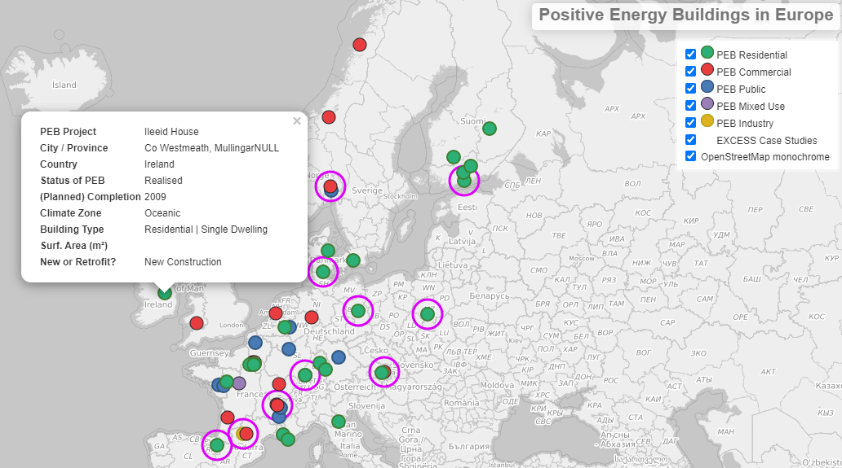
PEB stocktaking across Europe & case studies
58 PEBs identified
Over 400,000 m² surface area
Office buildings are the most common PEB type, followed by single family homes
PEB renovations still rare
PEB clusters in FR & DE
PEB tech varies across climates (PV universal)
PEBs = more stakeholders

Slide 8
Stocktaking – findings on regulations & incentives
Grid integration: Information found for 26 PEBs, but not detailed. In only 6 cases it is explicitly stated that surplus electricity is fed into the grid and feed-in tariffs are being availed of.
Funding / incentives: 22 PEBs publicly funded in their entirety. In 8 cases public subsidies / co-financing is mentioned.
Regulatory environments / specific incentive schemes: Very little information found in project documentation.
Conclusion: Excellent departure point for further research and interviews to explore impacts of regulations and incentives.

Slide 10
Case study: NEWTONPROJEKT Berlin (GER)
Realised by private building cooperative.
Partnership with the local district heating network operator.
Meets German KfW programme’s “plus-energy standard” (very prescriptive, does not address sustainability of building materials, but attractive financing).
Further support by German Federal Environmental Foundation (energy concept) & a Ministry (monitoring)
NEWTONPROJEKT House 1: total floor space of 1,085 m² / 13 apartment units

Slide 11
Case study: Hikari, Lyon (FR)
Collaboration between Lyon Métropole and the Japanese innovation accelerator NEDO.
Conceived as a lighthouse project: Pioneering new technologies required significant public financial support.
Insurance companies were not willing to let construction companies use innovative, custom-made building products such as the see-through photovoltaic façade.
The 12,200m² HIKARI complex includes offices, shops, apartments & 4 penthouses

Slide 12
Case study: Passivistas, Athens Metro (GR)
Energy renovation of 1960‘s house in the midst of the Greek economic crisis.
Supported by private sector sponsors and crowdfunding.
No government subsidies & unsupportive regulatory environment, but amortisation in under seven years via energy savings (even without sponsors / crowdfunding)
N.B. Feed-in tariffs very low and NZEB standard for newly constructed buildings suspended for one year in Greece.
125m² two-level structure with living space on top and office space on lower floor

Slide 13
Stocktaking – findings from the case studies
PEBs can already be an attractive proposition for public buildings, where time horizons are longer.
Privately initiated projects still require incentive schemes / public backing and elements of French & German programmes might show the way forward for other Member States.
Enabling the (bi-directional) integration of PEBs into electricity and thermal energy grids is a challenge, but can be done.
The energy renovation of detached houses to a PEB standard can already be economical, even without incentives and a supportive regulatory environment (when saving on labour costs and using conventional building materials)

Slide 14
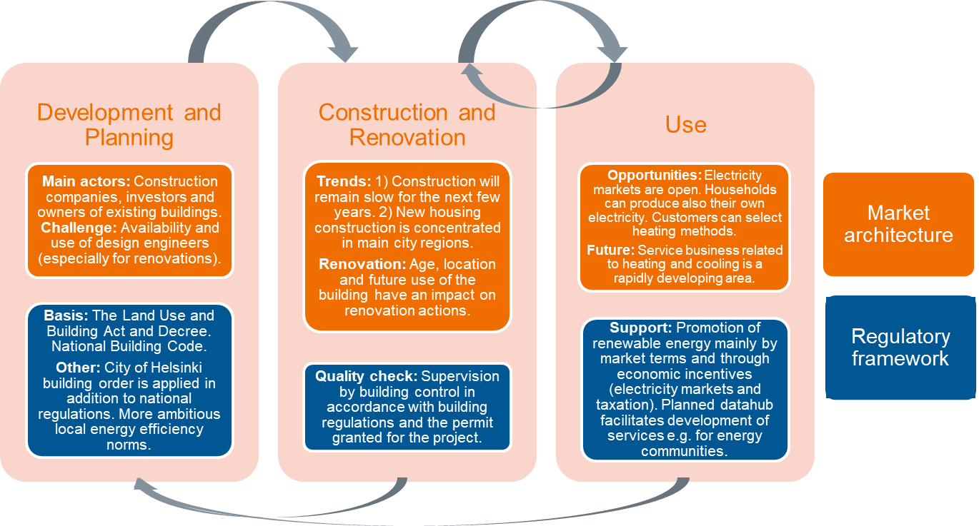
Research on barriers and incentives
Interviews on municipal and regional representatives, experts and urban planners in 15 cities and regions in EU.
Analysis of market and regulatory environments in the demo countries.

Slide 15
Market & regulatory environment (FI)

Slide 16
Findings: Regulatory barriers
Immaturity of regulations
Fragmentation of energy regulation (different fields and governance levels)
Inability of the regulations to handle different ownership structures and energy choices
Tight restrictions in historic buildings in combination with renewable installations

Slide 17
Findings: Regulatory incentives
Emerging regulatory framework for Local Energy Communities
Climate friendly regulation supports PEBs
Movement towards stricter energy efficiency targets on national level

Slide 18
Study on barriers and incentives

Slide 19
Recommendations – Technical & regulatory
Technical
Develop performance-based contracts, include maintenance.
Set up solid and experienced project management team to handle the complexity of the project.
Need for longer-term studies to show the energy savings compared to conventional systems.
Regulations
Develop an enabling, consistent (across various policy levels), stable and clear regulatory framework.

Slide 20
Recommendations – Social and financial
Social
Awareness raising campaigns to wide range of stakeholders including professionals.
Develop common, easily understandable Key Performance Indicators for PEBs.
Create tools and processes for peer-to-peer advice and information provision.
Financial
Funding and subsidies to support PEB solutions
The requirement to show the life-cycle effects should be made mandatory in the planning phase
Financing and incentive schemes at the national level
Introducing a CO₂ tax or an environmental tax could help in the roll-out of PEBs.
Notes:
Funding and subsidies to support PEB solutions. (Energy efficiency improvements and RES funding also helps)
The requirement to show the life-cycle effects (cost & environment) should be made mandatory in the planning phase. Financing and incentive schemes at the national level play a major role in promoting PEBs

Slide 21
Conclusions
The regulations are currently quite fragmented and not well aligned, but they seem to be developing towards enabling for PEBs.
The development of regulations calls for co-operation between stakeholders and different levels of governance.
In order to develop PEB supporting regulations, more information is needed of the concept and the challenges.
Incentives should be developed to support especially the lower-income people for acquiring PEBs

