Slide 1
Finnish PEB demonstration site at Kalasatama, Helsinki
Ismo Heimonen, VTT ismo.heimonen@vtt.fi

Slide 2
Introduction
PEB housing concept as target
Plot for developer Basso approved 2019
Project is part of City of Helsinki’s Re-thinking Urban Housing programme / Helsingin kaupungin Kehittyvä kerrostalo-hanke
Hitas* I rules => affordable owned apartments to Helsinkians
*Hitas is a system for regulating the price and quality of apartments in Helsinki, Finland. The system is intended to provide affordable owned apartments to Helsinkians. Apartments within the Hitas system are set a maximum selling price already when the lot is signed over for construction, and this maximum selling price may not be exceeded even when selling the apartment afterwards.

Slide 3
Plot at Kalasatama, Helsinki

Slide 4
Project at Kalasatama
2 buildings, EXCESS demo in lower one
  2-13 floors
145 apartments / 8254 h-m²
    House AB (As Oy Aurinkoamppeeri) 52 apartments / 2814 h-m²
    House CD (As Oy Geowatti) 93 apartments / 5440 h-m²
    Apartments 26,5 – 100 m², average 57m²
Restaurant and 4 commercial spaces, 456 m²
parking for 56 cars, underground space
  2 shared cars, by shared car services
Spaces for bikes inside 234, outside 97
Solar panels at facades and at roof
Challenging underground conditions, due to location in dense living area near harbour

Slide 5
Section

Slide 6
PEB technology
Deep boreholes 3-5x800m (drilling technology and heat exchangers collector)
70 kWel DualSun PVT panels:
  for multisource ground source heat pump with defrosting function
  and balcony integrated
PVs at facades
Seasonal borehole storage. PVT heat surplus will be used to charge the ground during transitional months, while during summer the HP condenser using the PVT as thermal source will dump heat to the ground.
Multisource ground source heat pump system for deep boreholes with high COP for DHW with 2x500 litre and 2x300 litre short term tanks and remote heat pump monitoring, on-line commissioning and fault diagnostics.
Utilisation of the excess heat of exhaust ventilation
Smart control and optimisation
Detailed planning going on

Slide 7
PVT panels at roof

Slide 8
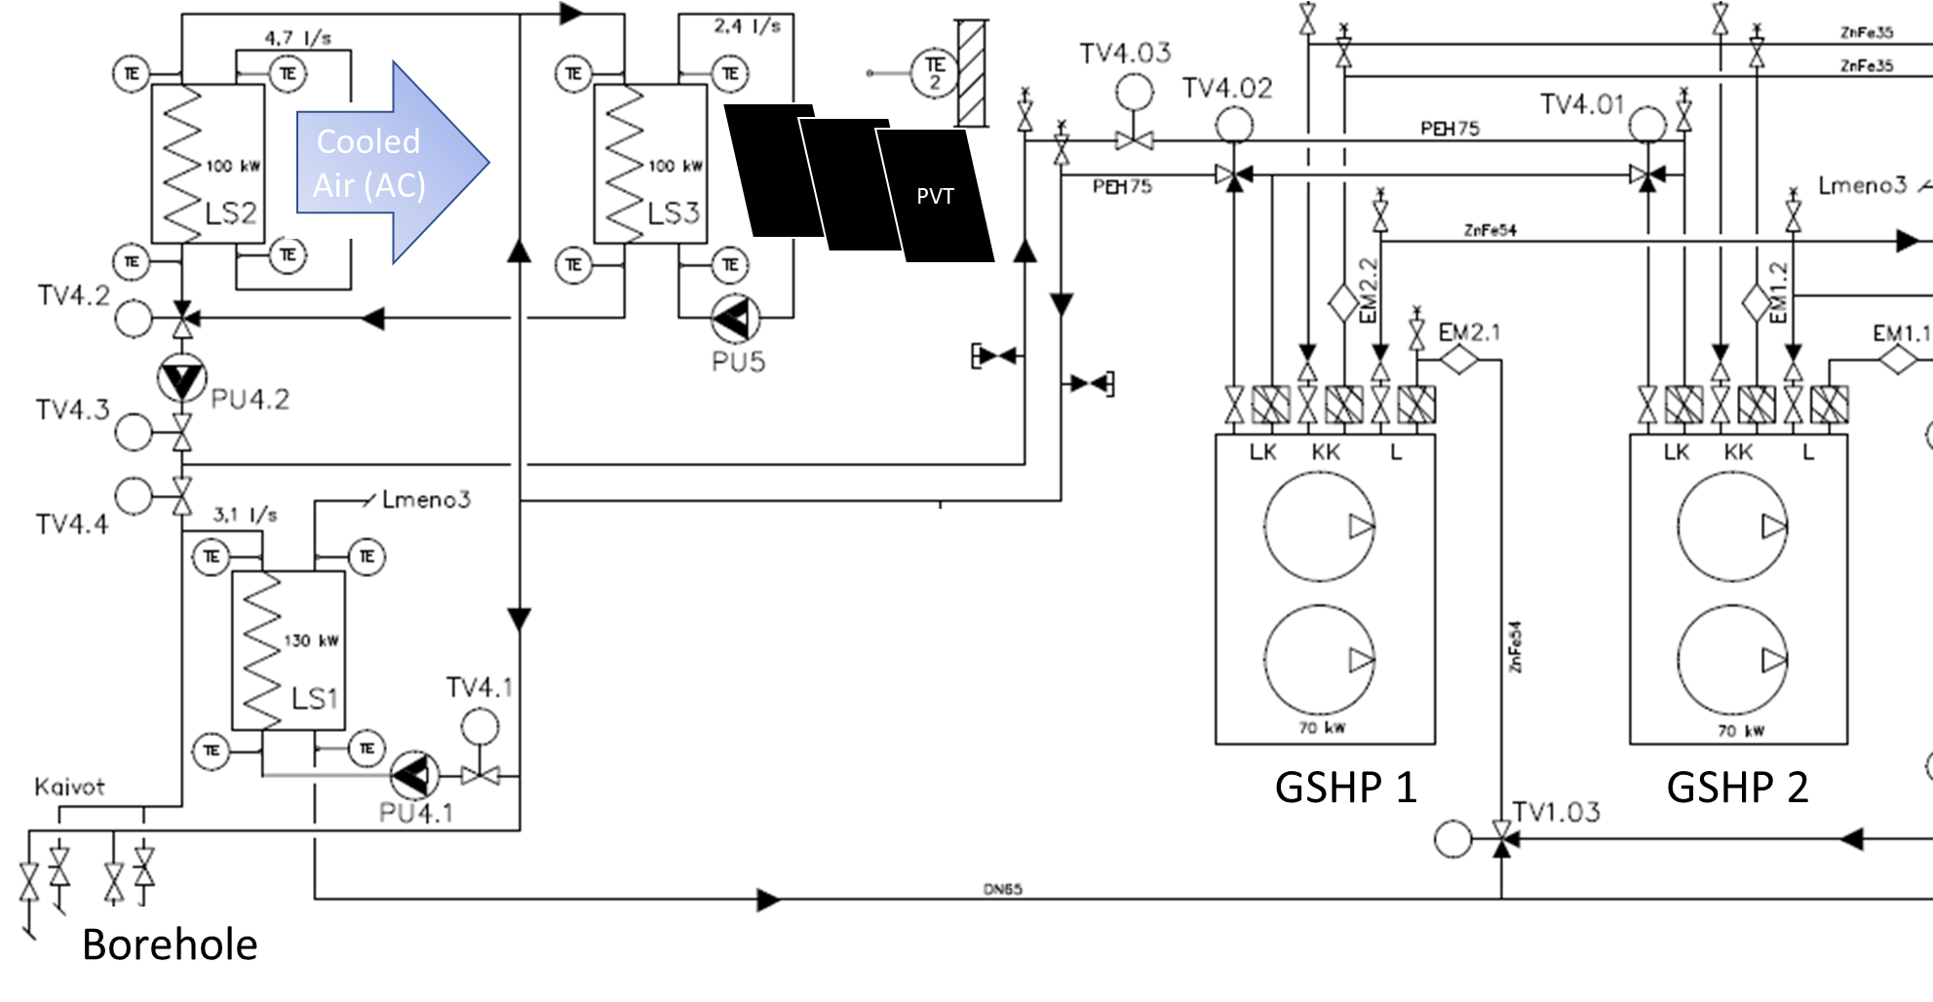
Hydraulic scheme and operation modes
Energy from PVT, ventilation and/or boreholes
Heat pumps
Heating of PEB and DHW
3 main operation modes

Slide 9
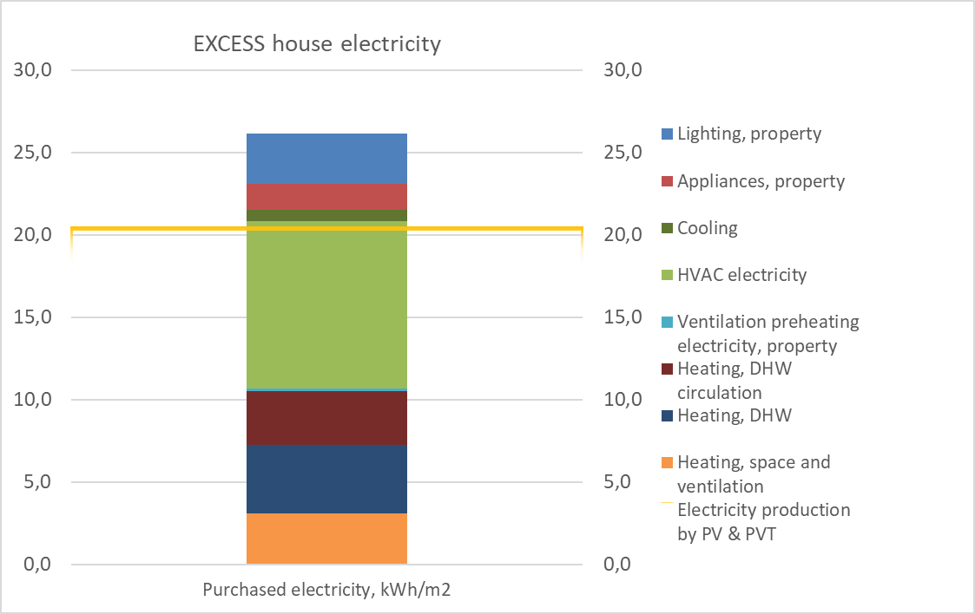
Energy balance – planning version
Definition of PEB – what is included?
  Now the planning solution is the house which doesn’t need heating (=produces as much as uses for heating)
  Restaurants, saunas etc energy intensive spaces not easy to solve
HVAC electricity is dominating the consumption
Development needs
  DHW and DHW circulation
Practical space limitations for PV & PVT
Calculation rules of building codes cause some challenges – waiting to see perfomance in the practise!

Slide 10
What‘s happening next?
3-11/2020: Planning for building permit
  Building permit expected 5/2021
12/2020 - Detailed planning continues
3/2021: Marketing starts, pre-marketing
4-5/2021: selection of buyers, among interested ones (Hitas-lottery)
5/2021 Start of sales ( after setting and presenting the governmental structure for the housing company)
5-8/2021: Cleaning the plot and preparatory construction works
9/2021-5/2023 construction

Slide 11
FIN demo team expertise
Basso – developer, hosting the case, housing concepts
  SWECO planning team (architectural, structural, geo, elements, HVAC, electric, energy, automation, fire, field plans)
Tomallen Senera – energy planning, geothermal & hybrid systems
Gebwell – heat pumps, heating and cooling systems
Muovitech – geothermal collectors, geothermal systems
Dualsun - PVT systems
VTT – research, performance evaluation, EXCESS WP4 lead
+ support of other EXCESS experts
+ sister project HYBGEO
+ City of Helsinki’s Re-thinking Urban Housing programme

Slide 12
Issues to raise & discuss
Definition of PEB – how to treat special cases, e.g. shops and restaurants, saunas, …
Expectations of differences between planning and real performance
Some notices of energy balance and consumption components (slide 9; DHW, DHW circulation, HVAC electricity)
Role of users on end result
Marketing of PEBs
  Developers careful in promising too much due to risk of reclamations
  Reference results are needed - waiting for EXCESS results

Slide 13
Thank you for your attention!

